Slide 1
Pragmatic Implementation Science Tools to Enhance the Impact of Your Research
HEAL Data2Action Research Adoption Support Center Guides and Measures

Slide 2
HD2A Research Adoption Support Center:
Evaluating the “Implementability” of an Intervention, Program, or Service
Heather J. Gotham, PhD
Stanford University School of Medicine
5th Annual NIH HEAL Initiative Scientific Meeting, Jan 7, 2024
NIDA 50DA054072, NIDA U2CDA057717

Slide 3






Authors & Acknowledgements
Heather Gotham, PhD Stanford University School of Medicine
Hélène Chokron Garneau, PhD, MPH Stanford University School of Medicine
C. Hendricks Brown, PhD Northwestern University
Sara Becker, PhD Northwestern University
William Becker, MD Yale University
Mark McGovern, PhD Stanford University School of Medicine
This work was supported by the National Institute on Drug Abuse (NIDA), National Institutes of Health (NIH) under award numbers P50DA054072 (PI: McGovern) and U2CDA057717 (Contact PI: McGovern). The content is solely the responsibility of the authors and does not represent the official position of NIDA/NIH.

Slide 4
Addiction and Pain Management Researchers want…
To increase the potential for translation and true public health impact for the interventions, programs or services they are designing, evaluating, or disseminating
To understand the potential real world “implementability” of their interventions ranging from pharmacological to psychosocial to data dashboards
To do more than qualitative interviews about barriers and facilitators in their Specific Aim 3
Pragmatic guidance from the field of implementation science….not theories, models, and frameworks

Slide 5
Pragmatic implementation science to improve the chance for translation: 5 key components
Evidence for the Intervention
Partner Engagement
Contextual Determinants
Implementation & Sustainment Strategies
Implementation & Sustainment Outcomes
Evidence for the Intervention: Research supporting the intervention’s effectiveness, delivery, and adaptation
Partner Engagement: Collaboration with partners (participants, sites, community) to define the population, problem, intervention, & strategies
Contextual Determinants: Systems, cultural, organizational, and individual factors that affect the reach and adoption of the intervention
Implementation & Sustainment Strategies: Procedures to support end-users to install and sustain the intervention
Implementation & Sustainment Outcomes: Effects of actions to implement the intervention including extent of use by the deliverers (adoption) and receivers (reach)

Slide 6
DIRC-SS: A pragmatic measure of “implementability” considerations in your research
Evidence for the Intervention
Partner Engagement
Contextual Determinants
Implementation & Sustainment Strategies
Implementation & Sustainment Outcomes
Five key dimensions
Concrete, practical value
Can be used to enhance your project at the proposal stage or to modify or augment your project if underway
  D&I Research Capability Self Survey (DIRC-SS)

Slide 7
What is the DIRC-SS?
Team-based self-assessment (1 hour)
No value judgement, consensus based, no implementation science expertise necessary
5 dimensions, 3-benchmarks per dimension (15 items total)
Global ratings on a 5-point scale from
1- None
3- Partial/Moderate
5- Full/Comprehensive/Complete
Honest ratings are best, using DIRC-SS to get to “5” is transparent
Sometimes zero, sometimes significant budget impact

Slide 8
DIRC-SS Applied: NIH HEAL Data2Action
10 Innovation/Acceleration Research Projects
3 Support Centers: DISC, MERC and RASC
RASC role to support the translation of Project findings
Method:
1) DIRC-SS review by Project PI and research team
2) DIRC-SS review by RASC Expert Dyads
3) Shared decision-making approach to develop “Implementation Support Plans”
4) Technical assistance to achieve revised project goals

Slide 9
DIRC-SS Applied: Findings
Baseline ratings across 9 HD2A Innovation and Acceleration Projects
Full
None
Evidence for the Intervention
Partner Engagement
Contextual Determinants
Implementation Strategies
Implementation Outcomes

Slide 10
DIRC-SS Applied: Key Takeaways
The DIRC-SS gathered systematic information from an existing or proposed research project
The DIRC-SS stimulated ideas about potential pragmatic opportunities to enhance the implementation aspects of the project
Led to fascinating, productive dialogue between HD2A Research Project teams and RASC implementation research experts
Exposed implementation science as an ironic implementation nightmare of theories, models, and frameworks with a beleaguering and infinite warehouse of options for non-experts

Slide 11

What Implementation Science Appears to Offer
Frameworks
Strategies
Measures

Slide 12

What the Field Needs

Slide 13
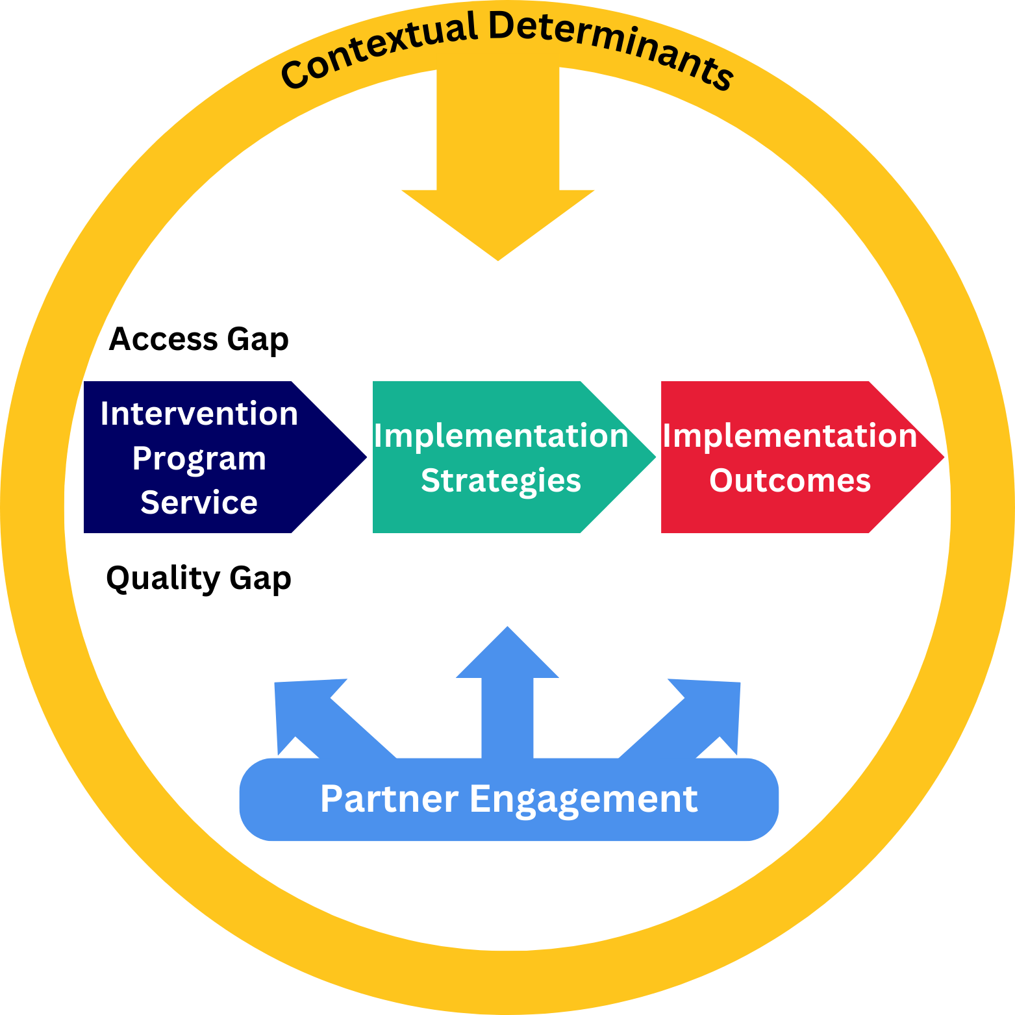
Pragmatic Guides and Measures Across
4 D&I Science Domains
Prioritizing rigor and reproducibility in measurement; and useability
C-DIAS/RASC Design & Development Workgroups
Partner Engagement: Terri Powell & Andrew Subica
Contextual Determinants: Cece Calhoun & Hélène Chokron Garneau
Implementation Strategies: Bryan Garner & Heather Gotham
Implementation Outcomes: William Becker & Beth McGinty

Slide 14
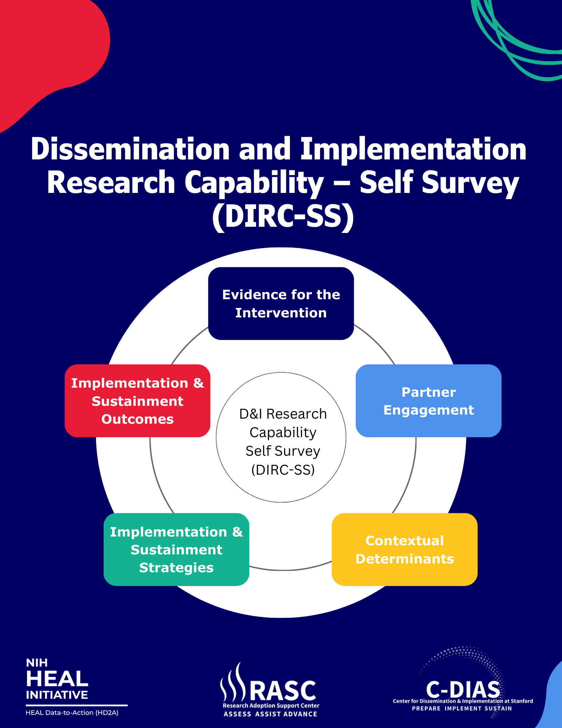

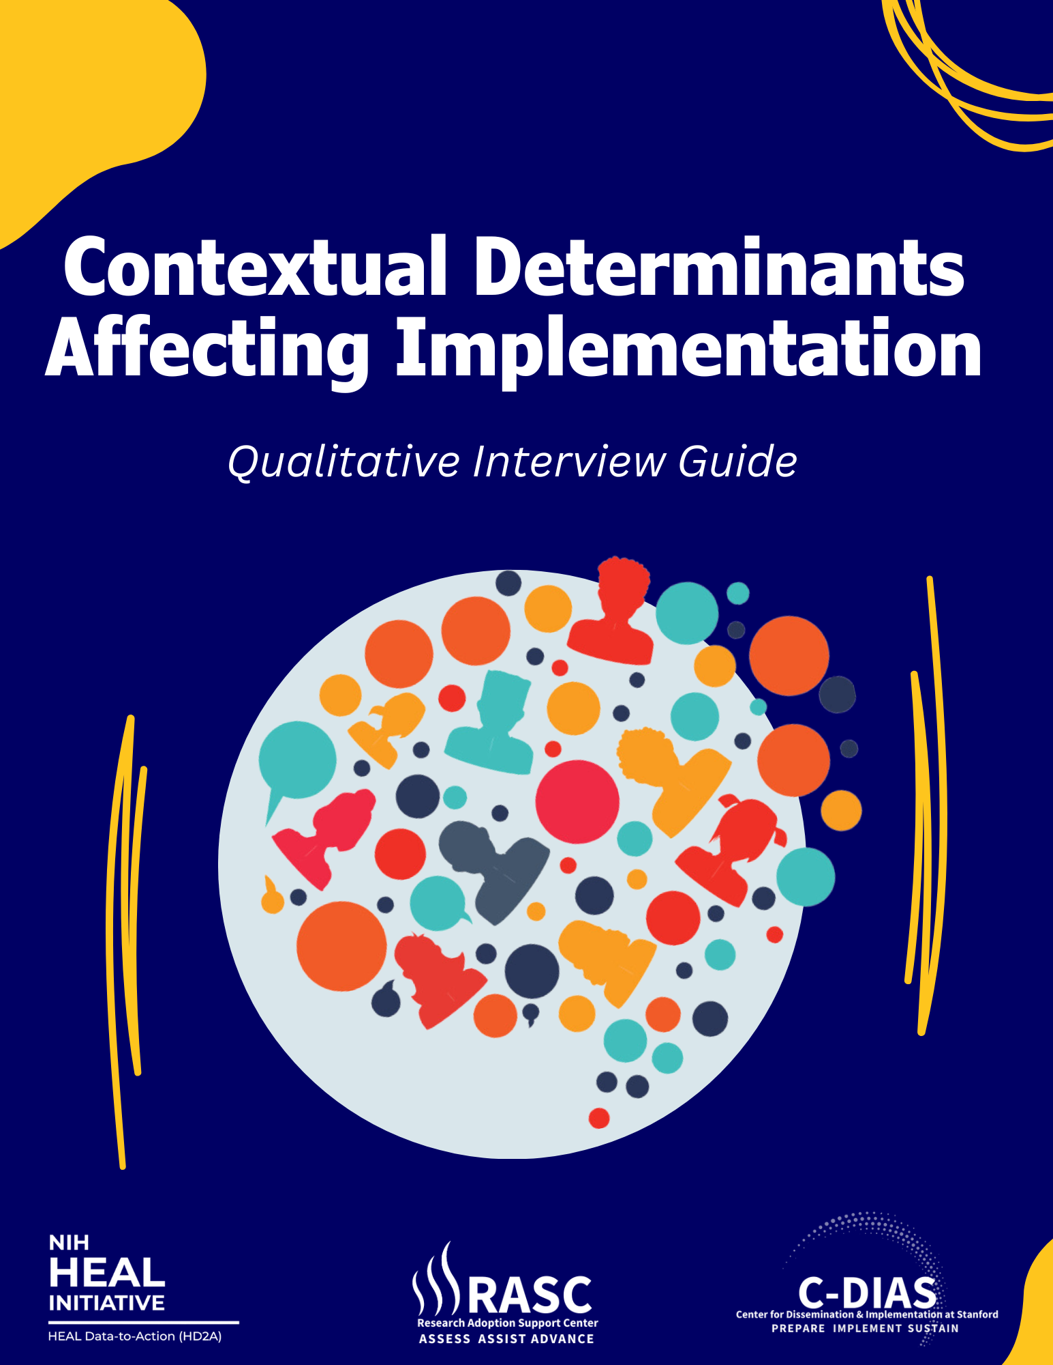

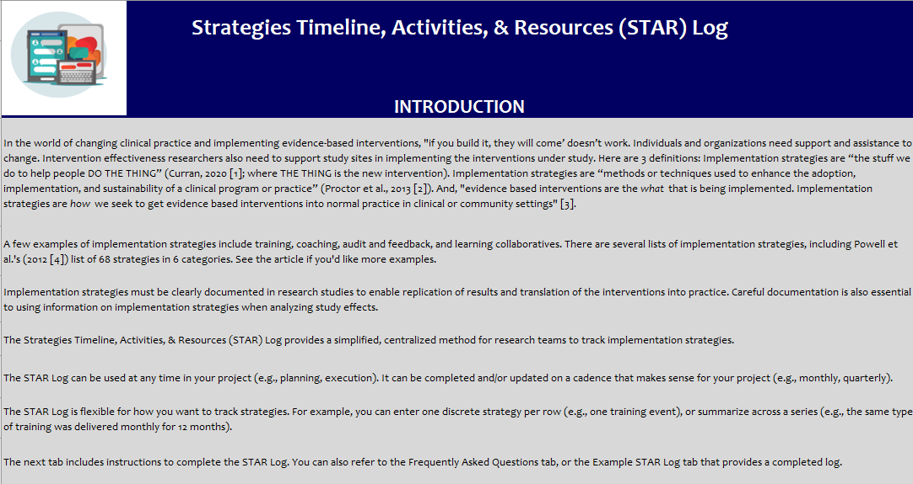
Available Now!
Download here:
www.hd2arasc.org/implementation-guides-and-measures

Slide 15
HEAL Data2Action Research Adoption Support Center:
Meaningfully Engaging and Integrating Partners into the Research Process
Terrinieka W. Powell, PhD
Johns Hopkins Bloomberg School of Public Health
5th Annual NIH HEAL Initiative Scientific Meeting, Feb 7, 2024
NIDA 50DA054072, NIDA U2CDA057717

Slide 16









Authors & Acknowledgements
Terrinieka Powell, PhD Johns Hopkins School of Public Health
Andrew Makoto Subica, PhD University of California Riverside
Heather Gotham, PhD Stanford University School of Medicine
Tamara Haegerich, PhD National Institute on Drug Abuse
Ayana Jordan, MD, PhD New York University
John Kelly, PhD
Harvard University
Jessica Magidson, PhD University of Maryland
Shubhi Sharma, MPH Stanford University School of Medicine
Faye S. Taxman, PhD George Mason University
Lindsey Zimmerman, PhD Stanford University
This work was supported by the National Institute on Drug Abuse (NIDA), National Institutes of Health (NIH) under award numbers P50DA054072 (PI: McGovern) and U2CDA057717 (Contact PI: McGovern). The content is solely the responsibility of the authors and does not represent the official position of NIDA/NIH. Dr. Haegerich was substantially involved in award U2CDA057717 consistent with her role as Scientific Officer.

Slide 17
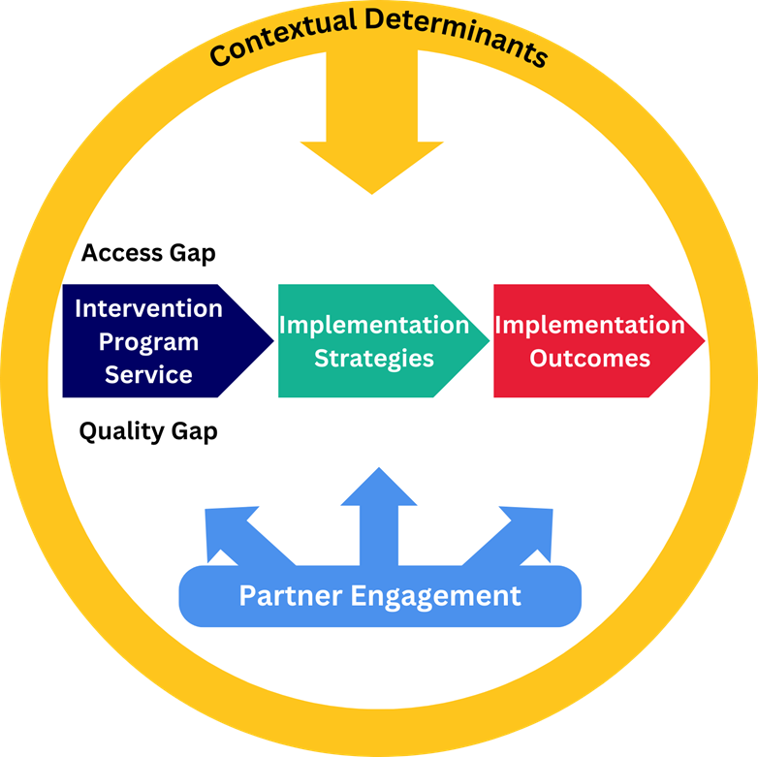
Partner Engagement
“A primary goal of D&I research is to achieve broad, sustainable use of an evidence-based program, policy, or practice, which requires inclusivity and shared ownership and buy-in from a range of partners and community members” (Villalobos et al., 2023)
Notes:
‘Partners’ refers to people, organizations, and communities that are affected by research. This includes patients and families, treatment and other organizations, communities, state and federal agencies, payors, and policymakers

Slide 18
Why is it important?
Crucial for developing effective and sustainable interventions across diverse groups/contexts
Necessary to improve the health and well-being of those affected by substance use disorders and pain
Poor partner engagement can negatively impact intervention outcomes and foster distrust among the affected groups
Notes:
Important approach to developing interventions that are effective across diverse groups/contexts and will be used and sustained in practice over time

Slide 19
Partner Engagement Resources
What has been done before?
Patient-Centered Outcomes Research Institute (PCORI) Engagement Resources
What are the current gaps?
Core principles and practices for researchers focused on addiction, pain, dissemination, and implementation
Accessible and practical resources
Our Partner Engagement Guide
Provides recommendations on how to identify and meaningfully engage with partners in research
Opioid Research Consortium of Central Appalachia (ORCCA) Community-Engaged Research Training
International Association for the Study of Pain (IASP) Partnering with People with Lived Experience
Helps researchers (1) improve the quality of their research and (2) increase empowerment among communities who partner with them
Notes:
Guide: especially those in underserved and underrepresented communities

Slide 20
Methods – National Team of Experts
Group meetings
Asynchronous work
Small-group meetings

Slide 21
Introduction to the Guide
Core Principles
The Partnering Process
Case Studies, Worksheets, and Resource List

Slide 22
Seven Core Principles
Co-Learning &
Co-Production
Equity
Humility
Relationship Building
Resource Sharing
Action & Change
Sustainment

Slide 23
The 6-Step Partnering Process
Planning Engagement
Putting Efforts into Practice
Promoting Evaluation & Dissemination
Step 1: Identify and secure needed support for partner engagement
Administrative support and time allocation
Compensation for partners
Space
IRB support
Step 2: Develop a partner engagement strategic plan
  Explore the WHY, WHO, WHAT, WHEN, and HOW
Notes:
SIX steps divided into three sections:
Planning engagement
Putting efforts into practice
Promoting evaluation and dissemination
All included with potential pitfalls

Slide 24
The Partnering Process
Planning Engagement
Putting Efforts into Practice
Promoting Evaluation & Dissemination
Step 3: Identify levels of engagement
Informing
Consulting
Collaborating
Leading/Co-Leading
Step 4: Select methods of engagement
Steering committee, advisory board, or workgroup
Open-ended guidance, prescriptive feedback, and/or human-centered design
Step 5: Engage partners in the research process
Engage partners throughout the research process
Monitor for engagement and possible conflicts
Notes:
Step 3: includes a table of questions to consider when determining level of engagement
Step 4: level and methods go hand in hand
Provide options that fit a range of research team types and needs

Slide 25
The Partnering Process
Planning Engagement
Putting Efforts into Practice
Promoting Evaluation & Dissemination
Step 6: Evaluate your engagement
Process evaluation: # and types of activities, # community members reached
Outcome evaluation: new community resources developed (increases in community partners’ staffing or membership), acceptability and feasibility of interventions, policy changes
Step 7: Disseminate information about your engagement strategy and outcomes
Develop materials with partners
Appropriately center the expertise and efforts of community partners

Slide 26
Two Case Studies
PEARL-PURPLE
Research Advisory Committee (RAC) at the University of Maryland-College Park Addictions Programs
Advised on programmatic/non-research projects and co-develop research proposals
RAC served as a social support and information-experience exchange platform
HEAL Justice Community Opioid Innovation Network
HEAL Justice Community Opioid Innovation Network (JCOIN) host a Practitioner Board and a Stakeholder Board
Started with goals of 0% tokenism and making engagement meaningful
Host a meeting series and tailor events and materials to different audiences
Notes:
Case Study 1: written by Dr. Jessica Magidson (Umaryland- Bmore)
Case Study 2: written by Jessica Hulsey (Addiction Policy Form)
- Series: what keeps you up at night

Slide 27
Supplemental Resources
Scientific Resources and Training for Partnership Engagement
Worksheets
Partner Engagement Strategic Plan Worksheet
Support and Resource Checklist

Slide 28
Impact and Implications
The goal is for researchers to improve the quality of their research by promoting partnered engagement with the affected communities
Engaging communities—particularly those historically excluded from health research processes and decision-making—is essential for translating substance use and pain interventions and programs for maximal public health impact
Ending addiction to substances, effectively managing pain, and reducing overdose deaths will require meaningfully engaging and integrating partners to help develop high-quality, equitable, and sustainable solutions

Slide 29
Available Now!
Download here:
www.hd2arasc.org/implementation-guides-and-measures

Slide 30
References
Engagement Resources | PCORI. (2018, October 9). https://www.pcori.org/engagement/engagement-resourcesOpioid Research Consortium of Central Appalachia Community-Engaged Research Training. (n.d.).
ORCCA. Retrieved January 12, 2024, from https://the-orcca.com/trainingPartnering with People with Lived Experience in Pain Research. (n.d.).
International Association for the Study of Pain (IASP). Retrieved January 12, 2024, from https://www.iasp-pain.org/resources/fact-sheets/partnering-with-people-with-lived-experience-in-pain-research/
Villalobos, A., Blachman-Demner, D., Percy-Laurry, A., Belis, D., & Bhattacharya, M. (2023). Community and partner engagement in dissemination and implementation research at the National Institutes of Health: An analysis of recently funded studies and opportunities to advance the field. Implementation Science Communications, 4(1), 77. https://doi.org/10.1186/s43058-023-00462-y

Slide 31
Thank You!

Slide 32
HEAL Data2Action Research Adoption Support Center:
Understanding the Context in which Interventions Are Implemented
Cecelia Calhoun, MD, MPHS, Yale University
5th Annual NIH HEAL Initiative Scientific Meeting, Feb 7, 2024
NIDA 50DA054072, NIDA U2CDA057717

Slide 33









Authors & Acknowledgements
Cecelia Calhoun, PhD Yale University
Helene Chokron Garneau , PhD, MPH
Stanford University
Greg Aarons, PhD University of California San Diego
Ana Baumann, PhD Washington University in St. Louis
Laura Damschroder, MS, MPH, Implementation Pathways, LLC
Rebecca Lengnick-Hall, PhD, MSW, MPA, Washington University in St. Louis
Brian Mittman, PhD Kaiser Permanente
Lawrence Palinkas, PhD, MA, University of California San Diego
Shari Rogal, MD, MPH University of Pittsburgh
Praise Olatunde, MSPH
Stanford University
This work was supported by the NIH National Institute on Drug Abuse through P50D054072, and by the NIH National Institute on Drug Abuse through the Helping to End Addiction Long-term® Initiative, or NIH HEAL Initiative® as part of the HEAL Data2Action Program under grant number U2CDA057717.

Slide 34
Contextual Determinants
Factors that affect the implementation and sustainment of evidence-based practices and innovative solutions
May be conceptualized as barriers and facilitators
Multi-leveled and dynamic

Slide 35
Why does context matter?
Context shapes the intervention's implementation, delivery, and sustainment
Guides selection of implementation strategies to successfully increase the intervention's reach, adoption, maintenance, and sustainability

Slide 36
What has been done before?
Many frameworks exist
Consolidated Framework for Implementation Research (CFIR)
Promoting Action on Research Implementation in Health Services (PARIHS)
Theoretical Domains Framework (TDF)
Practical, Robust Implementation and Sustainability Model (PRISM)
Gaps
These frameworks and tools are complex to use for non researchers
Data is difficult to harmonize limiting cross-study comparability, reproducibility, and pooled findings

Slide 37
Purpose
To develop a pragmatic, user-friendly guide which identifies the contextual determinants that influence the implementation of a chosen intervention

Slide 38
Methods
Identified a team of experts
Co-chair leadership
Group meetings
Asynchronous work
Iterative design

Slide 39
Priorities of the workgroup
Fluid & non-prescriptive
Captures context at multiple levels
Four audiences: Intervention developers; Intermediary/purveyor organization;
Public and private health or social service systems; Implementation Researchers
Considers equity
Captures how contextual factors may influence each other
Pragmatic & user friendly

Slide 40
Product
Contextual Determinants Affecting Implementation
Qualitative Interview Guide
Semi-structured
Self-administered or used as a guide for qualitative interviews
Probes organized around common domains of major frameworks
Equity-focused lens

Slide 41
Contextual Determinants Affecting Implementation
Can you think of any challenges or barriers to:
  Getting (NAME OF INTERVENTION) implemented?
  Getting (NAME OF INTERVENTION) delivered as intended? And
  Slowing down, interfering, or halting the process?
Can you think of anything that will (or did) help to:
  Get (NAME OF INTERVENTION) implemented?
  Get (NAME OF INTERVENTION) delivered as intended?
  Reinforce or accelerate the process?
Can you think of ways that these barriers and facilitators are connected to one another (i.e., how they may work together)?
How would you define implementing this intervention in an equitable fashion, in your context, for the population that you work with? What may get in the way of making this happen?
What kinds of disparities exist among [recipients]?
  How might implementing [service] help close those gaps?
  How might [service] implementation make those gaps worse?
  What should we avoid so we don't make things worse?
Multi-level probes
Systems
Organization
Clinical or site
Individual provider
Characteristics of the intervention
Patient
Notes:
Focus on Equity
Identify ways to implement the intervention equitably
Consider obstacles faced by historically marginalized populations
Identify strategies to address disparities in your interventions context

Slide 42
Impact and Implications
This guide will allow for:
Easy and wholistic assessment of determinants and their interconnectedness
Use the information gathered to develop an implementation roadmap based on which contextual determinants are most readily addressable
Focus on equity
Guide the selection of implementation strategies

Slide 43
Available Now!
Download here:
www.hd2arasc.org/implementation-guides-and-measures

Slide 44
References
Damschroder LJ, Reardon CM, Widerquist MAO, Lowery J. The updated Consolidated Framework for Implementation Research based on user feedback. Implement Sci. 2022;17(1):75. Published 2022 Oct 29. doi:10.1186/s13012-022-01245-0
Feldstein AC, Glasgow RE. A practical, robust implementation and sustainability model (PRISM) for integrating research findings into practice. Jt Comm J Qual Patient Saf. 2008;34(4):228-243. doi:10.1016/s1553-7250(08)34030-6
Kitson A, Harvey G, McCormack B. Enabling the implementation of evidence based practice: a conceptual framework. Qual Health Care. 1998;7(3):149-158. doi:10.1136/qshc.7.3.149
Michie S, Johnston M, Abraham C, et al. Making psychological theory useful for implementing evidence based practice: a consensus approach. Qual Saf Health Care. 2005;14(1):26-33. doi:10.1136/qshc.2004.011155

Slide 45
HEAL Data2Action Research Adoption Support Center:
Documenting Strategies that Support Implementation of Effective Interventions
Bryan R. Garner, PhD, The Ohio State University
5th Annual NIH HEAL Initiative Scientific Meeting, Jan 7, 2024
NIDA 50DA054072, NIDA U2CDA057717

Slide 46







Authors & Acknowledgements
Bryan Garner, PhD The Ohio State University
Heather Gotham, PhD Stanford University School of Medicine
Sara Becker, PhD Northwestern University
Hannah Knudsen, PhD University of Kentucky
Todd Molfenter, PhD University of Wisconsin, Madison
Byron Powell, PhD Washington University in St. Louis
Lisa Saldana, PhD Chestnut Health Systems – Lighthouse Institute
JD Smith, PhD University of Utah
Mia Navarro, MS Stanford University School of Medicine
This work was supported by the NIH National Institute on Drug Abuse through P50D054072, and by the NIH National Institute on Drug Abuse through the Helping to End Addiction Long-term® Initiative, or NIH HEAL Initiative® as part of the HEAL Data2Action Program under grant number U2CDA057717.

Slide 47
Implementation Strategies
“the stuff we do to help people DO THE THING (i.e., intervention)” (Curran, 2020)
“methods or techniques used to enhance the adoption, implementation, and sustainability of a clinical program or practice” (Proctor et al., 2013)
There are several existing lists of implementation strategies
  Powell et al.’s (2015) Expert Recommendations for Implementing Change (ERIC)

Slide 48
Why Track Implementation Strategies?
Allow other researchers to replicate the results of a study
  What happened to get the intervention used in study sites?
Translate interventions into practice
  What steps are needed to embed an effective intervention into a real-world setting?
Analyze intervention effects
  Did differences in implementation strategies affect differences in intervention outcomes across sites or samples?

Slide 49
Why is This Tool Needed?
Researchers have strategy tracking methods
  Bunger et al. (2017) - Tracking Implementation Strategies
  Boyd et al. (2018) - A Method for Tracking Implementation Strategies
  Walsh-Bailey et al. (2021) - A pilot study comparing tools for tracking implementation strategies
  Smith et al. (2023) - Longitudinal Implementation Strategy Tracking System (LISTS)
However, there is a need for a more simple, pragmatic tool
  Doesn’t rely on D&I experts
  Flexible and modifiable based on level of specificity needed
  Easy for research staff to use

Slide 50
Methods
Sought feedback from research collaborators
[TBC] Piloting with research collaborators
Identified a team of experts
Regular team meetings
Facilitator meetings

Slide 51

Strategies Timeline, Activities, & Resources (STAR) Log
Provides a simplified, centralized method for research teams to track implementation strategies
Can be used at any time in your project (e.g., planning, execution)
Can be completed and/or updated on a cadence that makes sense for your project (e.g., monthly, quarterly)
Strategies Timeline, Activities, & Resources (STAR) Log

Slide 52
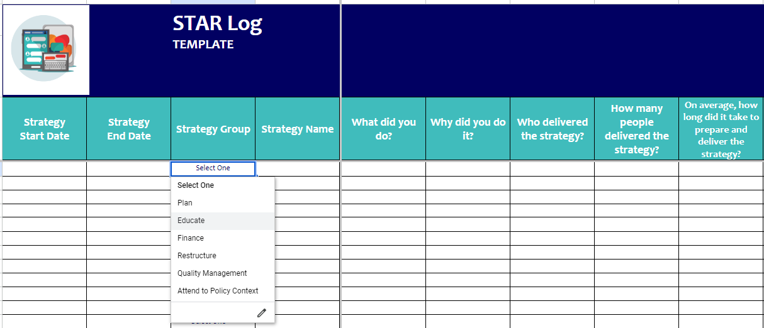
Strategies Timeline, Activities, & Resources (STAR) Log

Slide 53
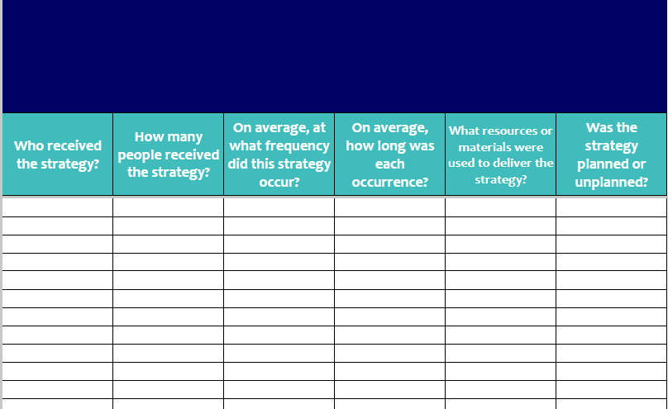
Strategies Timeline, Activities, & Resources (STAR) Log

Slide 54
Impact and Implications
How can the STAR Log be used?
  Outline resources and costs needed while planning a study
  Replicate interventions in research studies or real-world settings
  Track adaptations in implementation strategies used
  Facilitate cost-effectiveness analyses to share with policymakers and government officials
  Harmonize information across studies in meta-analyses or other reviews

Slide 55
Available Now!
Download here:
www.hd2arasc.org/implementation-guides-and-measures

Slide 56
HEAL Data2Action Research Adoption Support Center:
Integrating Implementation Outcomes into Effectiveness Studies
William C. Becker, MD, Yale University
5th Annual NIH HEAL Initiative Scientific Meeting, Jan 7, 2024
P50DA054072, U2CDA057717

Slide 57






Authors & Acknowledgements
Beth McGinty, PhD
Weill Cornell Medicine
William Becker, MD
Yale University
Margarita Alegria, Massachusetts General Hospital
Hannah Knudsen, PhD University of Kentucky
Joe Glass, PhD
Kaiser Permanente Washington Health Research Institute
Patience Moyo Dow, PhD Brown University
Karen Seal, MD, MPH University of California, San Francisco
Lia Chin-Purcell, MS Stanford University School of Medicine
This work was supported by the National Institute on Drug Abuse (NIDA), National Institutes of Health (NIH) under award numbers P50DA054072 (PI: McGovern) and U2CDA057717 (Contact PI: McGovern). The content is solely the responsibility of the authors and does not represent the official position of NIDA/NIH.

Slide 58
Implementation Outcomes
Implementation outcomes measure how much and how well an intervention was implemented
Popular frameworks for measuring implementation outcomes include
  Proctor et al. (2011): acceptability, appropriateness, adoption, feasibility, fidelity, implementation cost, penetration, and sustainability
  RE-AIM: reach, effectiveness, adoption, implementation, and maintenance (Glasgow 1999).

Slide 59
Implementation Outcomes (Proctor et al., 2011)
Acceptability: Extent to which the intervention is considered suitable, agreeable, and satisfactory
Appropriateness: Perceived fit of the intervention for a practice setting, provider, or participant
Adoption: Decision by an organization or provider to take on or deliver an intervention. Also known as “uptake”
Feasibility: Extent to which the intervention can be successfully used in a given setting considering context, resources, etc.
Fidelity: Degree to which the intervention is implemented as the protocol prescribes
Implementation cost: Financial cost of delivering the intervention
Penetration: Degree of use of the intervention within the population of organizations, providers, and clients - also known as “reach”
Sustainability: Extent to which a newly implemented intervention is maintained with an organization’s ongoing operations

Slide 60
Why Embed Implementation Outcome Measures in Effectiveness Studies?
Clarify reasons for the intervention's success or failure
Address variability across contexts - unique sites and diverse patient groups
Accelerate research-to-practice translation
Inform how to tailor implementation strategies
Assist in long-term planning
Aid in understanding impact in real-world settings
Notes:
Clarify Reasons for the Intervention's Success or Failure
Determine if an intervention's outcomes are due to its inherent effectiveness or the quality of its implementation
Address Variability Across Contexts
Explain differences in results across unique sites and patient groups
Accelerate Research-to-Practice Translation
Aid in swiftly converting research findings into actionable practices
Inform Better Implementation Strategies
Guide researchers in tailoring how an intervention is implemented to fit different organization and patient needs for improved uptake
Assist in Long-term Planning
Help in assessing the sustainability and cost of interventions over time
Aid in Understanding Impact in Real-World Settings
Measure the practical application and real-world effectiveness of interventions

Slide 61
Why is This Specific Guide Needed?
Several lists or repositories of outcome measures, but no guide to why, when, or how to use them
Our guide uniquely includes case studies that demonstrate practical applications
Notes:
Unlike the Implementation Outcomes Repository, the guide is tailored to incorporate outcome measures into effectiveness research, providing specific guidance for selecting appropriate measures for each study. The repository complements our guide to house existing instruments for measuring the outcomes.
While the Implementation Outcomes Crosswalk, for example, caters to HIV research, our guide is specially designed for researchers focused on substance use disorders and overdose prevention.
Our guide uniquely includes case studies that demonstrate the practical application of these measures in real-world settings.

Slide 62
What Our Guide Provides
Define outcomes
Supply tools for selection
Bridge the gap between research and routine practice
Provide case studies
Notes:
To provide a detailed understanding of Proctor et al.’s seven implementation outcomes, offering guidance on their application in various research scenarios.
To supply tools for selecting and measuring implementation outcomes effectively, ensuring relevance to the specific needs of leaders, providers, and patients within studies.
To allow researchers to bridge the gap between research and routine practice by embedding implementation outcomes into effectiveness studies.

Slide 63
Methods
Interdisciplinary Collaboration
Formed workgroup including experts in dissemination and implementation (D&I) science, opioid use disorder, and pain management
Defined Implementation Outcomes using Proctor et al.
Adopted the Proctor et al. (2011) framework to define the implementation outcomes
Selection Criteria
Came to consensus on criteria for selecting implementation outcomes based on study context and targeted population
Iterated on decision criteria for each outcome
Inclusion of Real-World Examples
Incorporated case studies from published studies to demonstrate the application of these methods

Slide 64

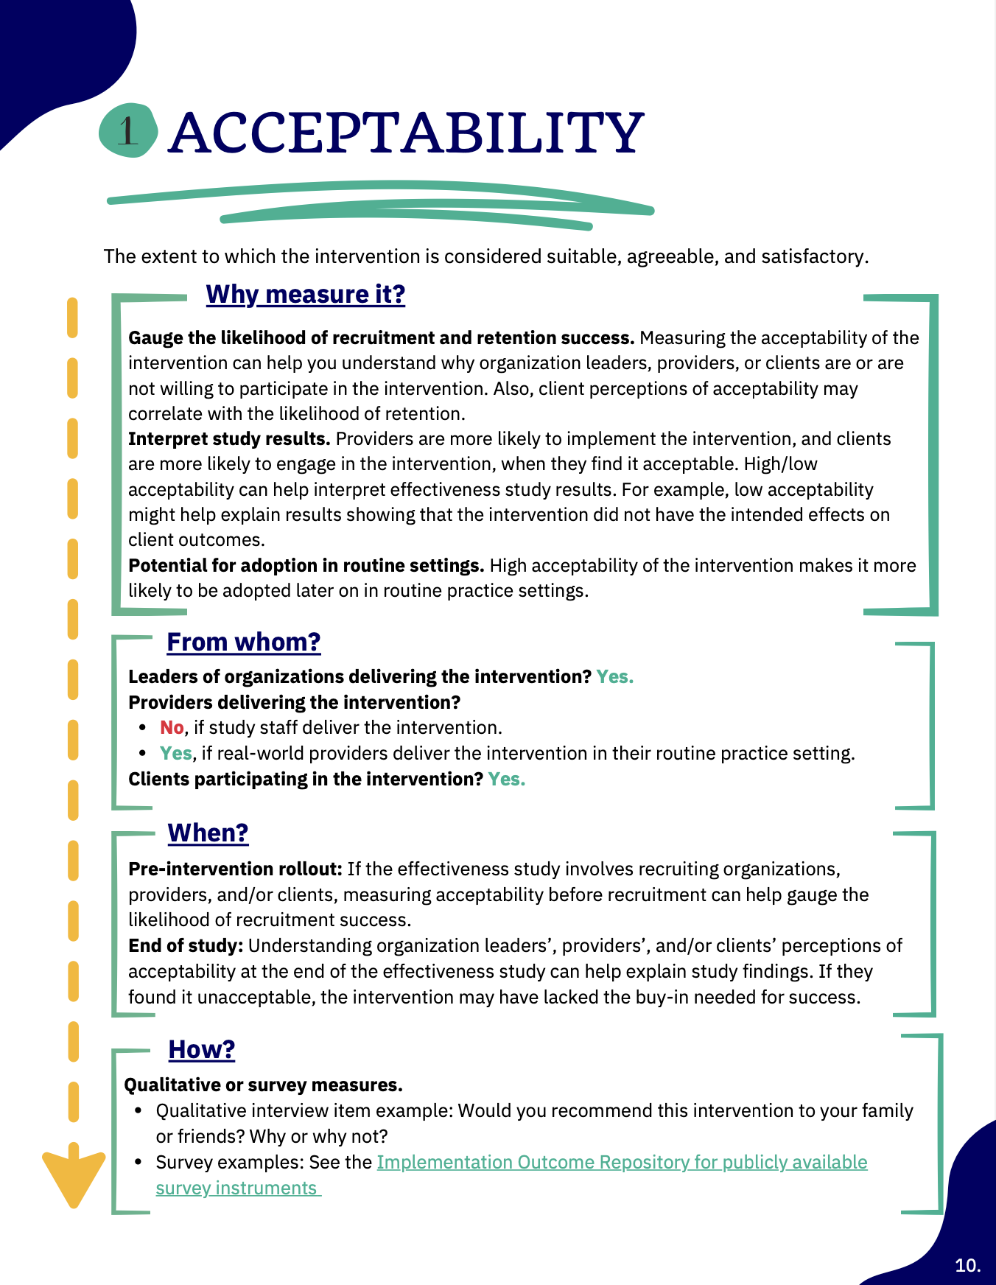
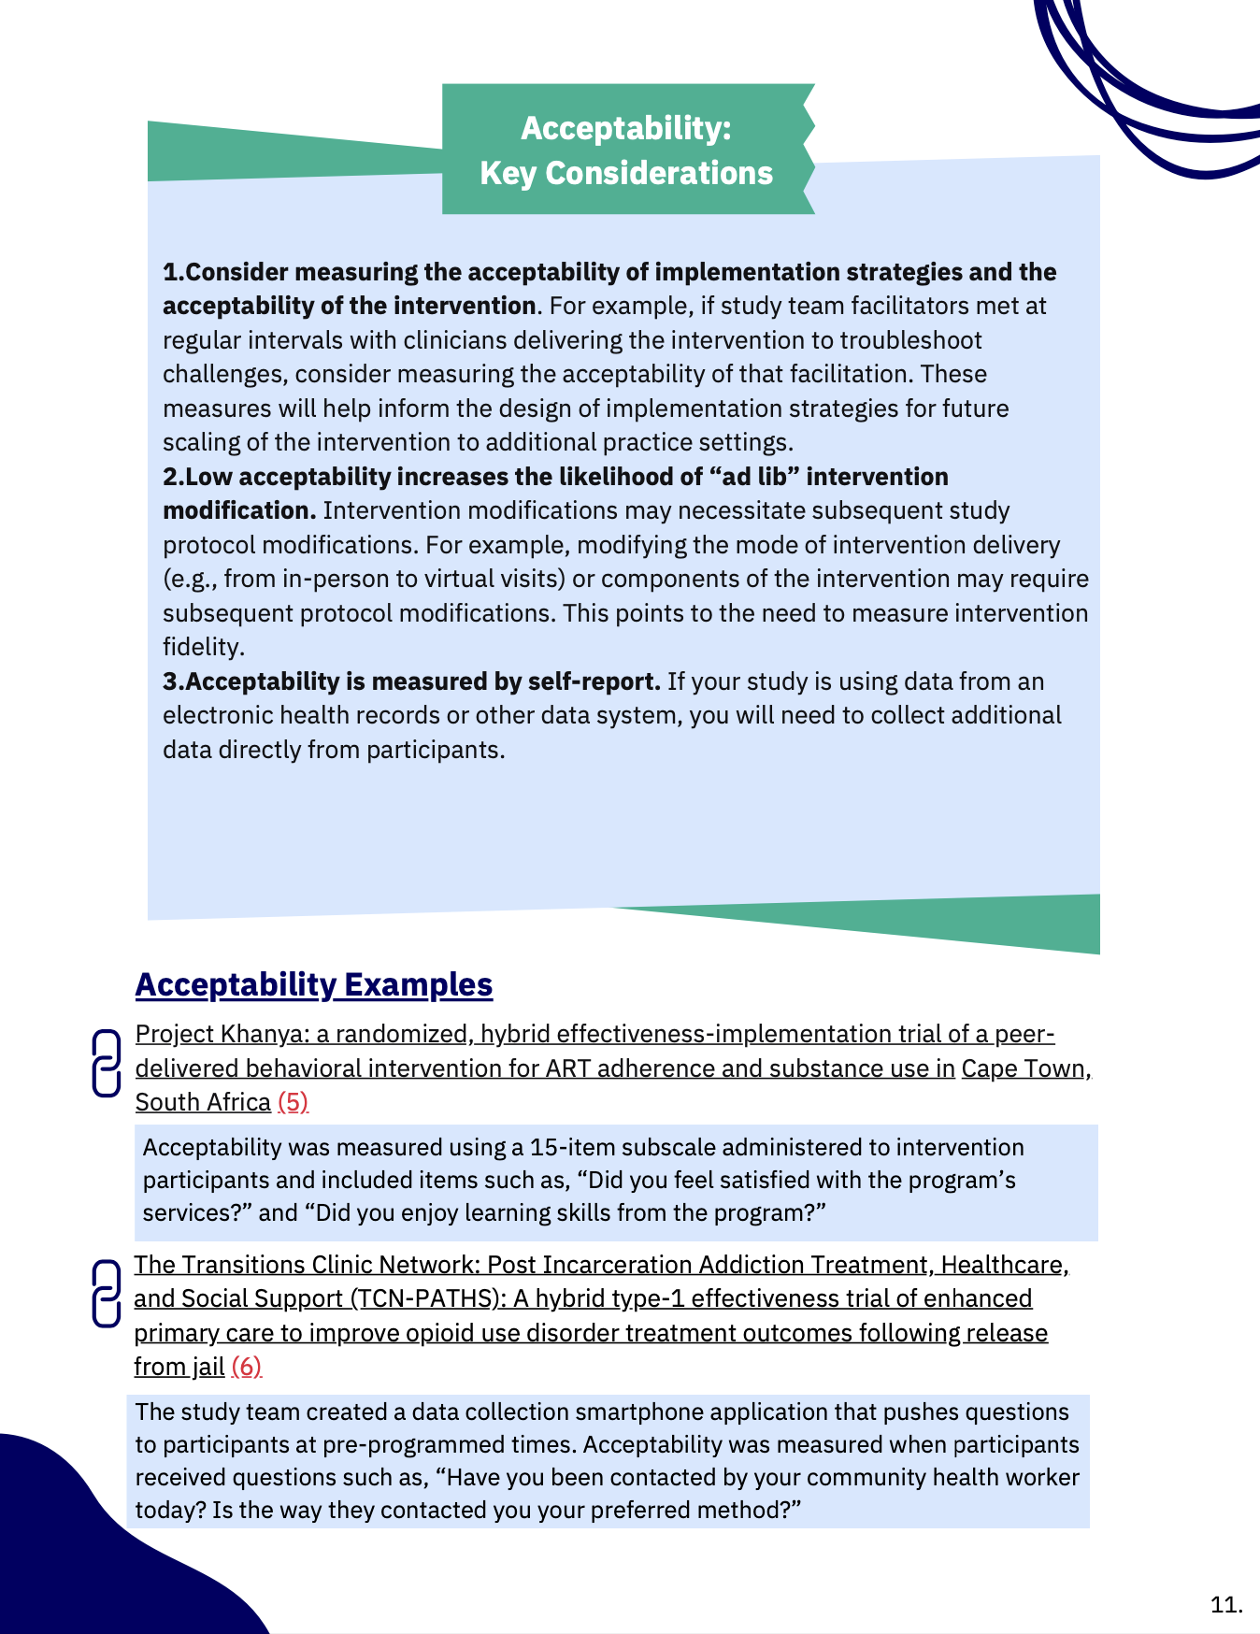
Integrating Implementation Outcomes into Effectiveness Studies

Slide 65
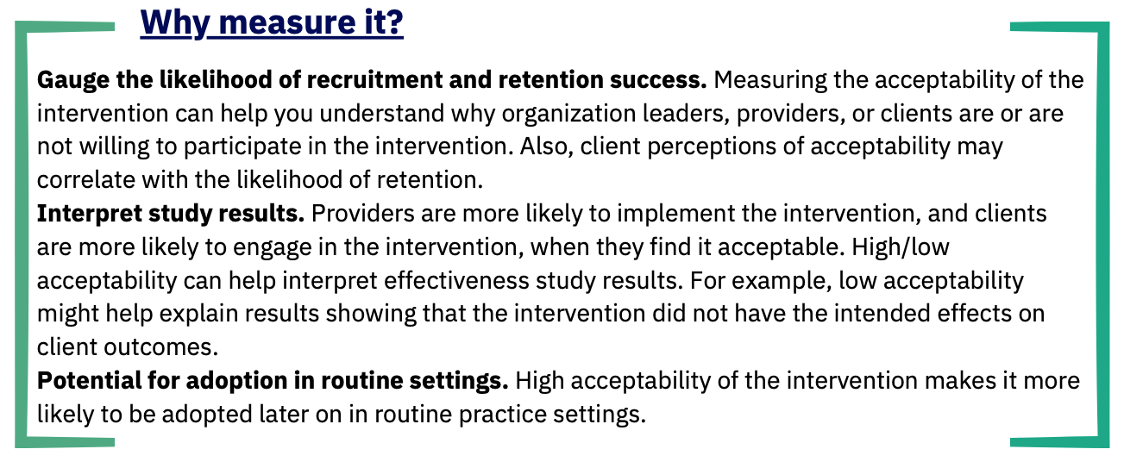
Integrating Implementation Outcomes into Effectiveness Studies
Example: Acceptability

Slide 66
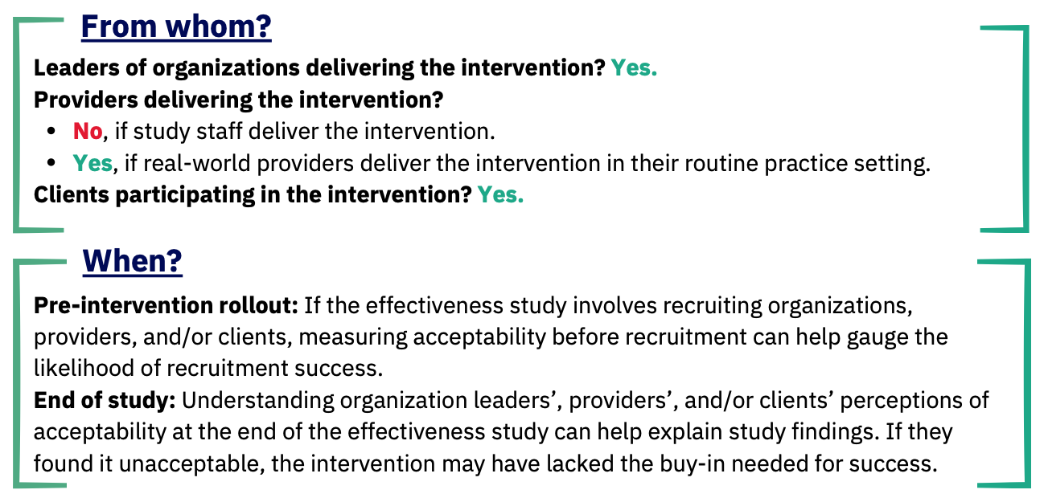
Integrating Implementation Outcomes into Effectiveness Studies
Example: Acceptability

Slide 67
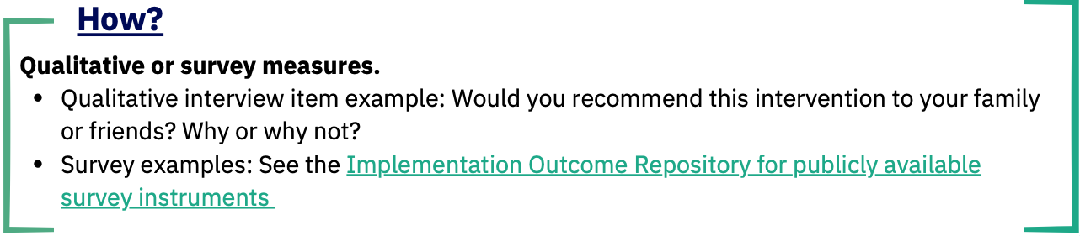
Integrating Implementation Outcomes into Effectiveness Studies
Example: Acceptability

Slide 68
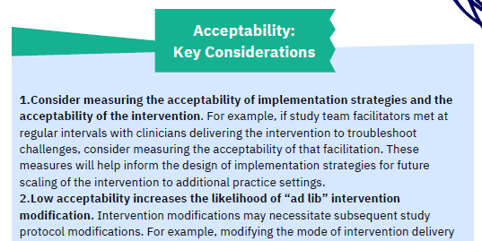
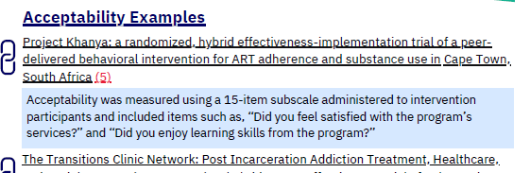
Integrating Implementation Outcomes into Effectiveness Studies
Example: Acceptability

Slide 69
Impact and Implications
Improves Implementation Quality
  Identify and address factors that influence intervention delivery
Encourages Sustainable Practices
  Plan for long-term sustainability of interventions
Reduces Research-to-Practice Gap
  Aims to shorten the time between discovery and practical application, leading to faster improvements

Slide 70
Available Now!
Download here:
www.hd2arasc.org/implementation-guides-and-measures

Slide 71
Pragmatic Implementation Science Tools to Enhance the Impact of Your Research
HEAL Data2Action Research Adoption Support Center Guides and Measures
Discussion and Q&A
Tamara Haegerich, PhD
National Institute on Drug Abuse

Slide 72
Themes
Limited success in moving the needle on the overdose crisis and improving pain management
  Interventions do not implement themselves
Considering implementation enhances ability to use data for action
  Real world integration
  Interpretation of effects
  Replication
  Maximization of public health benefit
Context matters for implementation
  Assess
  Understand
  Influence
Inclusivity, shared ownership, and empowerment is critical
  Interventions are about people
  Historical exclusion
Frameworks and principles help, but tools are required
  Simple, pragmatic, flexible guides
  Research and practice application
  Prioritize what is meaningful and actionable
  Case studies
Vision: Improve research quality and reduce the research-to-practice gap

Slide 73
Discussion Questions – Panelists and Audience
What have been the main barriers and facilitators to integrating implementation considerations into intervention research in pain and addiction?
For researchers, how has engaging partners in your research changed your approach, questions, or methods?
For partners, what have been your experiences with the benefits (or harms) of engaging with researchers?
How and why is addressing implementation context and outcomes and engaging partners important for health equity?
What can researchers do “late in the game” to integrate implementation and partner objectives into their project?
What other resources and tools could be helpful in making implementation and engagement concepts actionable?

