Slide 1
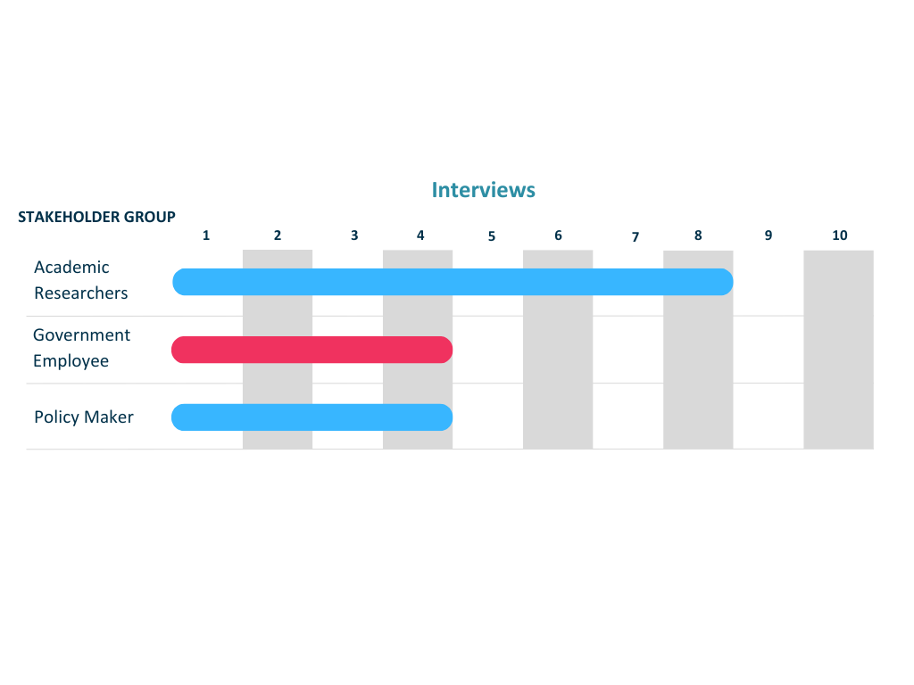
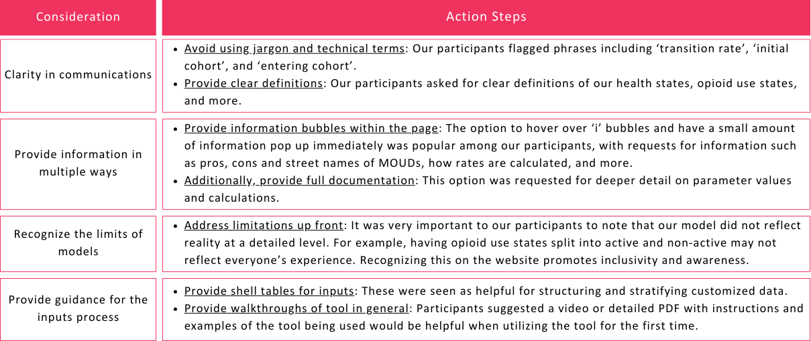
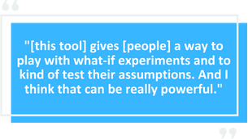
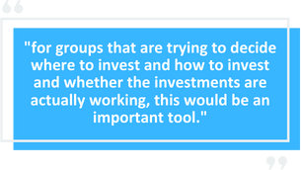
HEAL D2A Modeling and Economic Resource Center (MERC): Semi-Structured Interviews to Support Opioid Intervention Decision-Making
Hana Zwick, MSc (1), Jocelyn Vititow (1), Caroline Savitzky, MSW (1), Matthew Carroll, MS (1), Dimitri Baptiste, MS (1), Stavroula A. Chrysanthopoulou, PhD (2), Natalie C. Benda, PHD (3), Benjamin P. Linas MD (1, 4) (1) Boston Medical Center, Boston, MA, (2) Brown University School of Public Health, Providence, RI, (3) Columbia University School of Nursing, New York, NY, (4) Boston University, Boston, MA
NIH NIDA Grant Numbers: U24DA057650, P30AI042853, R01DA046527
Abstract
Results
This research aims to inform the design of an online tool to support decision making regarding opioid-use interventions.
We have completed sixteen qualitative interviews to date to understand stakeholder perspectives on current online tools and needs for future tools.
Results provide formative themes that shed light on the factors that impact real-world decision making about policies to mitigate the overdose crisis.
Round 1 results identified a major concern of potential for misinterpretation. In Round 2, we spoke with two academic researchers, two government employees, and three policy makers engaged in opioid-related intervention implementation and found that the following considerations are critical for effectively communicating technical work.
Methodology
Recruitment: we utilize email listservs to recruit participants from relevant research consortia and professional networks.
Interview guide: iteratively developed and pilot tested, informed by Sittig and Singh’s Sociotechnical Model.
Data collection: remote, semi-structured interviews.
Data analysis:
Transcribed interview recordings on Zoom for data analysis.
Used inductive approach with 2 independent coders to develop data-driven themes.
Conducted using NVivo 13 software.
Introduction
As one component of the NIDA Data 2 Action Modeling and Economics Resource Center (MERC), we are developing an online decision-making tool that will allow real-world policy makers to use a simulation model to experiment with policy options and project likely outcomes and budgetary impact.
We are interviewing potential users of the tool to inform design, identify best practices, and understand possible applications.
The themes we identify will inform the online tool and provide insight into the factors that influence policy making in the overdose crisis.
Participants also shared their thoughts on potential applicability and direct use:
Conclusion
Online tools to support substance use care decision making have significant potential, but also face substantial challenges. Our ongoing research has identified four considerations critical to the success and use of such tools, as well as how our proposed tool may be useful in choosing interventions or distributing resources. Our continued effort will use our findings to develop a user interface and help improve how substance use care decisions are made on a larger scale.
Next Steps:
Funding
We would love to speak with you! If you’re interested in being a part of our work and would like to be interviewed as a stakeholder, please scan our QR code.
This project is funded by the National Institute on Drug Abuse (U24DA057650, P30AI042853, R01DA046527).

