Slide 1
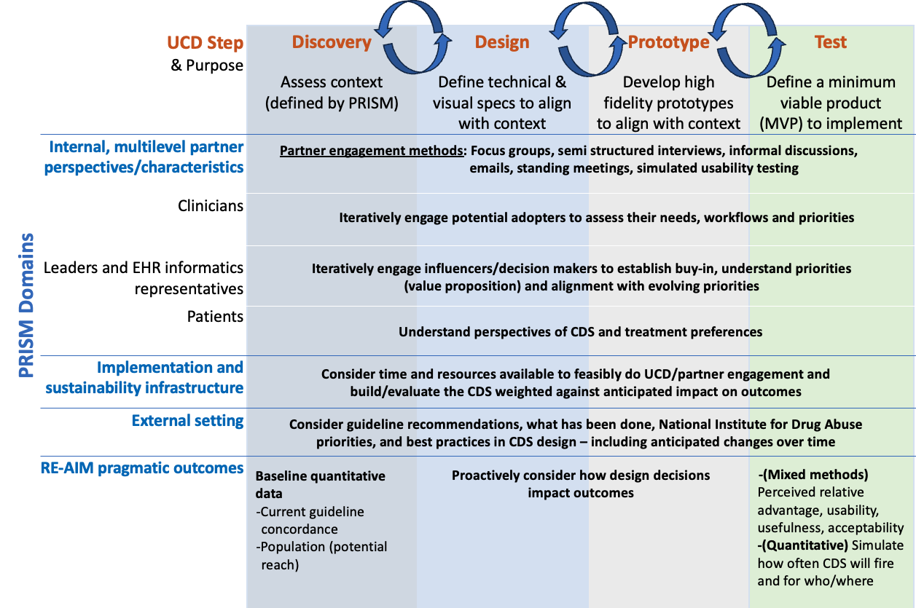
Integrating PRISM with user-centered design: Decision support for safe opioid prescribing
Katy Trinkley, PharmD, PhD; Bethany Kwan, PhD, MSPH;
Heather Tolle, PhD; Brad Morse, PhD; Jason Hoppe, DO
University of Colorado Anschutz Medical Center
Background
Figure 1. PRISM-UCD Integrated Approach to Design of CDS for Opioid Prescribing Guidelines
(including multilevel and user-centered partner engagement methods)
Results
The opioid crisis persists despite evidence-based recommendations to improve:
Safe opioid prescribing
Effective pain management
Implementation strategies are needed to increase clinician uptake guidelines
Strategies often include clinical decision support (CDS) tools within the electronic health record
Design of CDS benefit from Implementation science (IS) and user-centered design (UCD) to enhance potential adoption, implementation, and sustainability
Objective: Describe and apply an approach to design CDS for uptake of opioid prescribing guidelines across a large integrated health system using IS and UCD
Opioid prescribing guideline CDS priorities and relevance to clinical setting
Guideline | Setting(s)
Naloxone co-prescribing | All
Opioid use disorder treatment | All
Minimize opioids for initial chronic pain treatment | Primary Care
Minimize long-term opioid exposure | Primary Care
CDS design feature priorities
Making patients’ prior/current opioid easily accessible
Consider broad users (nurses should also have easy access)
Fewest ‘clicks’ possible
Firing logic must be accurate
CDS implementation – potential strategies
Address clinician education gaps on guidelines
Identify individuals as domain experts to champion OUD efforts, generally, and the guidelines, specifically
Promote standardized culture/practices
Emphasize strategic priority in communications to demonstrate leadership buy-in
Making Patient Reported Outcomes (PRO) useful and data-driven
Patients advocated for relationships with clinicians and value 1:1 conversation
Methods
We applied an integrated IS and UCD approach based on alignment of the Practical, Robust Implementation and Sustainability Model (PRISM) with UCD (Figure 1) to identify:
Setting relevant guidelines
CDS design feature priorities
Potential implementation strategies
Discovery and design steps of this approach included multilevel and user-centered partner engagement:
1-hour facilitated discussion with a community advisory board (5 community members)
5 focus groups with 25 clinicians in multiple settings (primary care (8), emergency medicine (11), inpatient hospital medicine (6))
1:1 informal meetings with health system leadership
Analysis: Mural boards to synthesize design concepts from partner engagement transcripts and notes
Future Directions
Funding: Research reported in this publication was supported by the National Institute On Drug Abuse of the National Institutes of Health under Award Number R61DA057610. The content is solely the responsibility of the authors and does not necessarily represent the official views of the National Institutes of Health.
Develop and test the priority CDS features and implementation strategies
Iteratively apply/adapt the integrated PRISM-UCD approach to other CDS and technology innovations in diverse situations
Dowel D, Raga KR, Jones CM, Baldwin GT, Chou R. CDC clinical practice guideline for prescribing opioids for pain – United States, 2022. MMWR Recomm Rep. 2022;71:1-95.
Trinkley KE, Kahn MG, Bennett TD, Glasgow RE, Haugen H, Kao DP, Kroehl ME, Lin CT, Malone DC, Matlock DD. Integrating the Practical Robust Implementation and Sustainability Model with best practices in clinical decision support design: Implementation science approach. J Med Internet Res. 2020;22:e19676.

